Slide 1
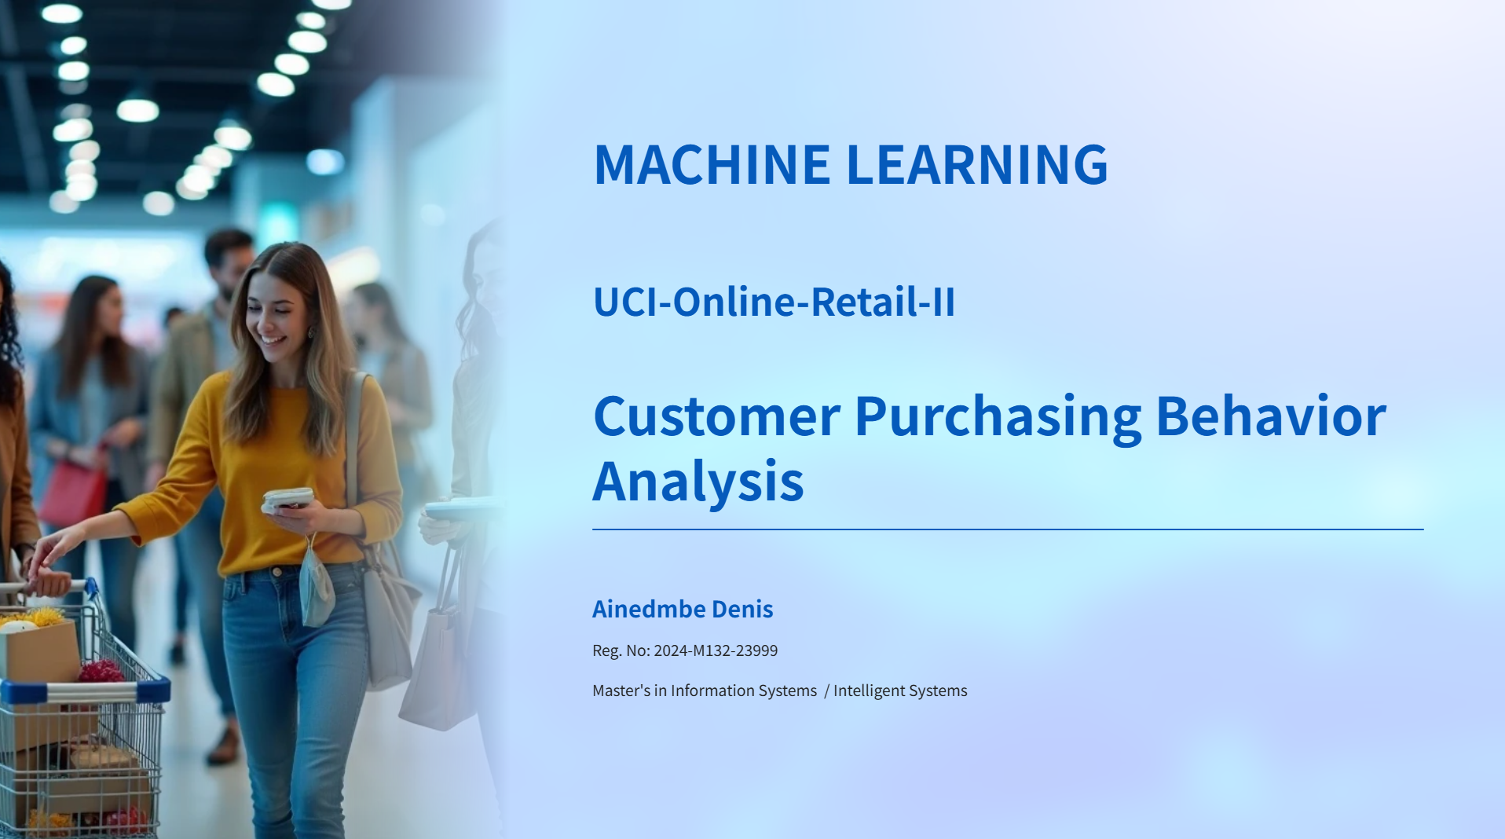

GitHub Repo:
https://github.com/Ainedembe-Denis/UCI-Online-Retail-II-Customer-Purchasing-Behavior-Analysis

Slide 2
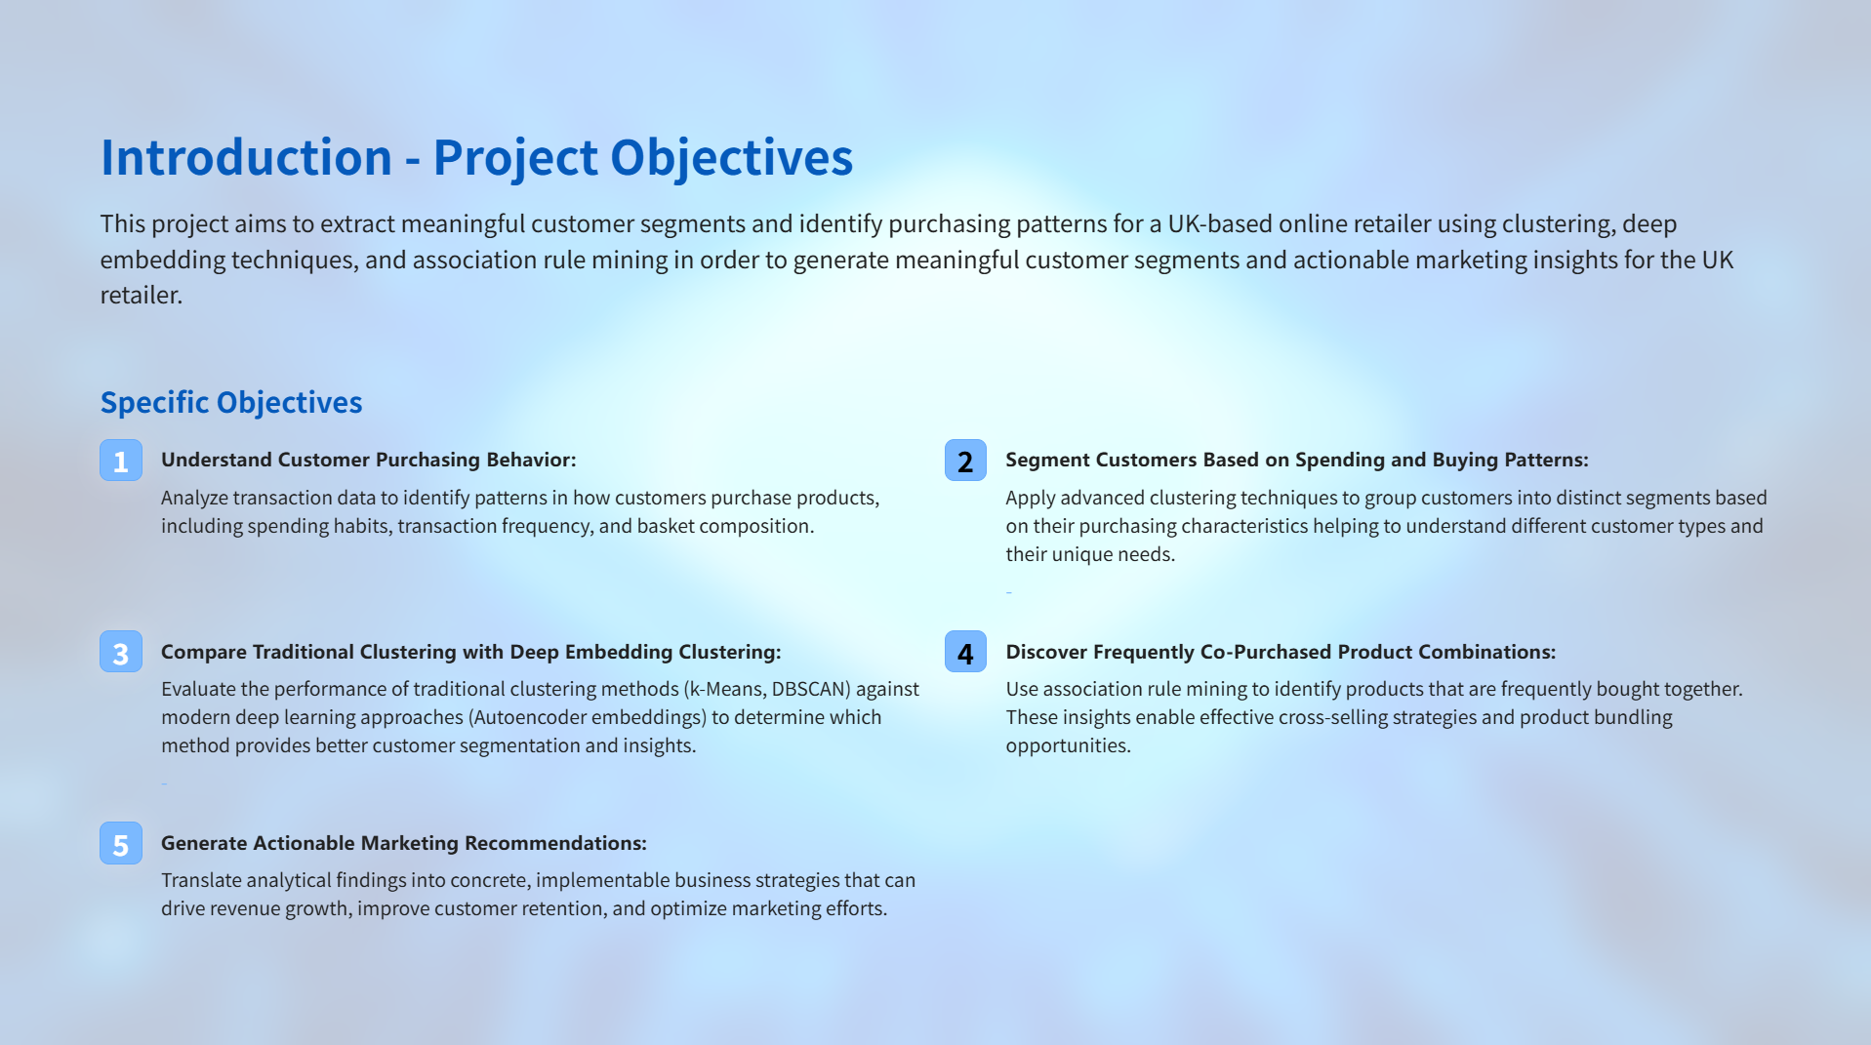

Slide 3
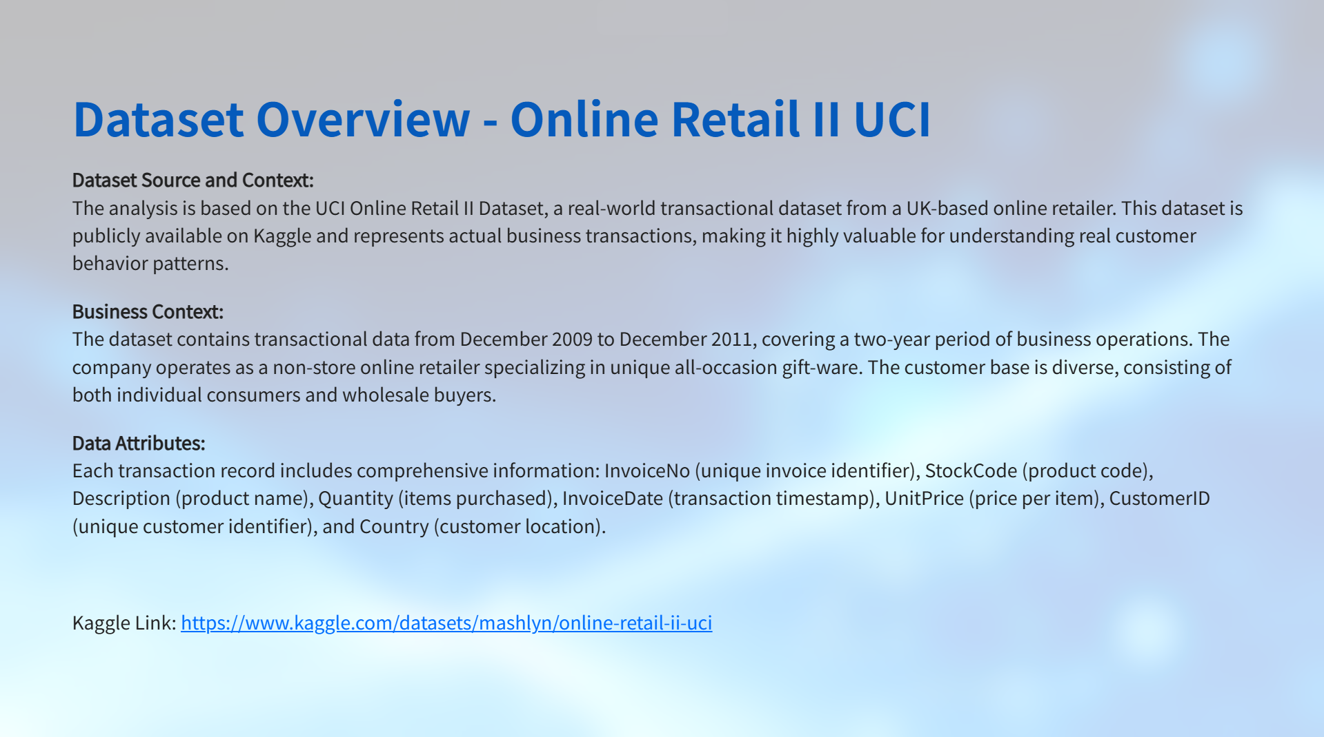

Slide 4
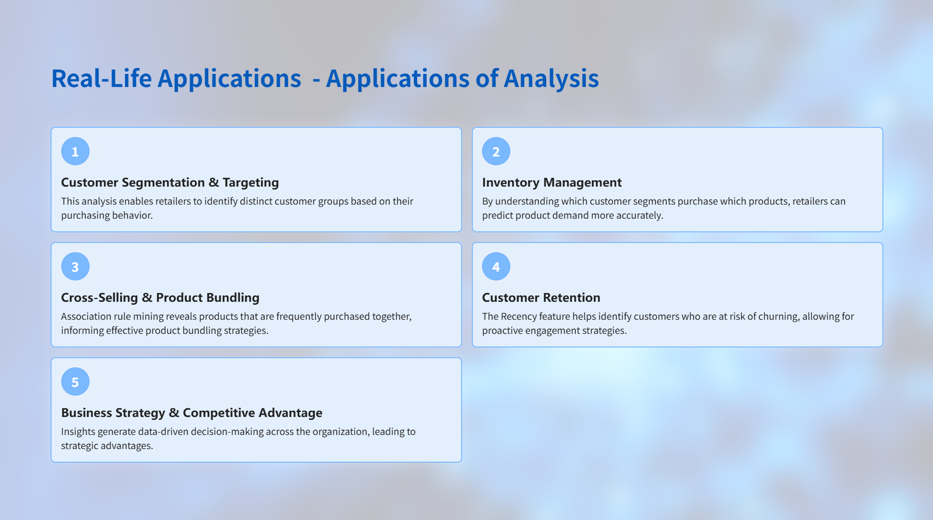

Slide 5
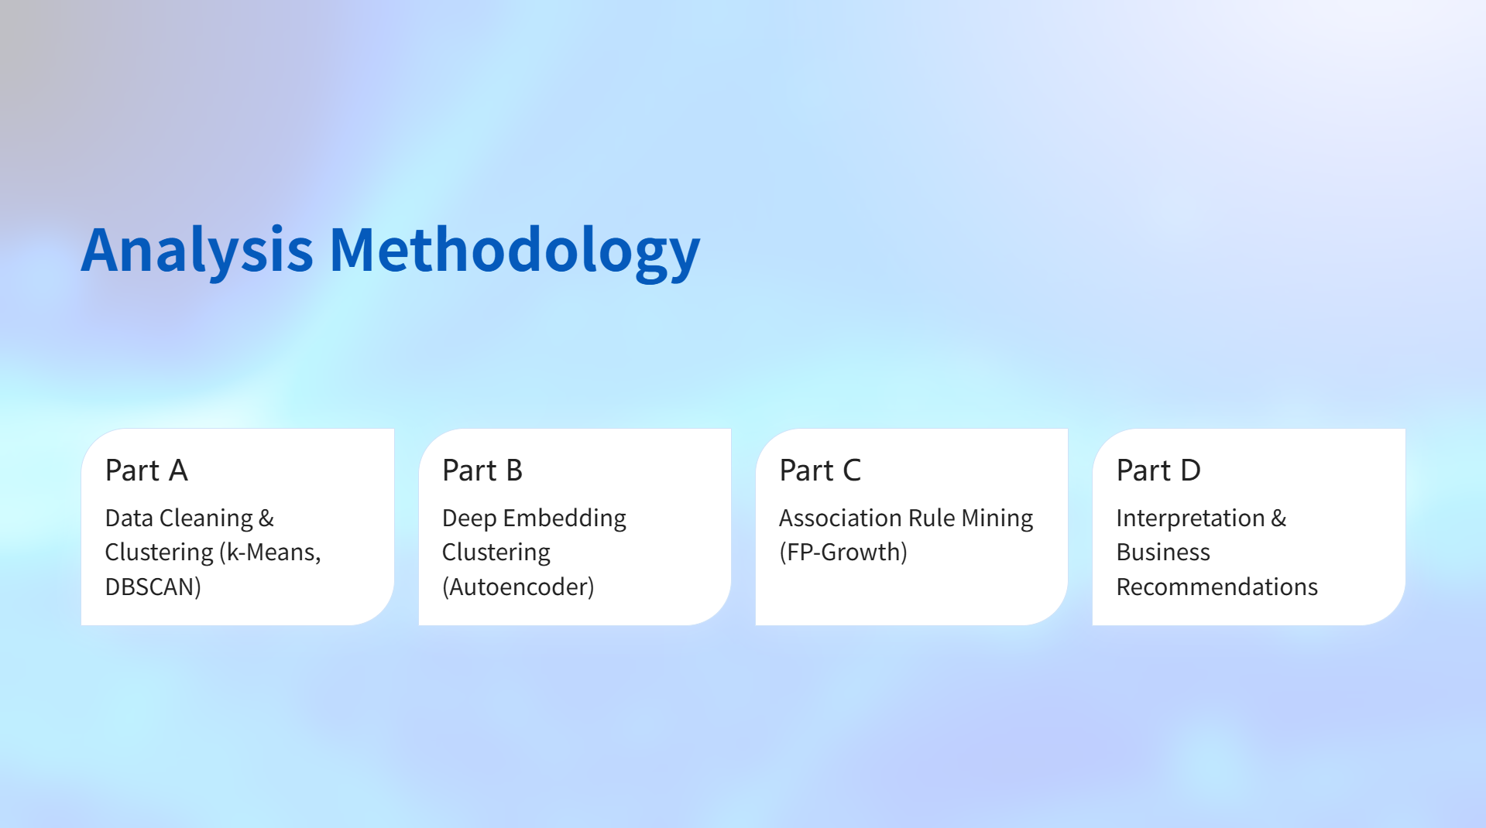

Slide 6

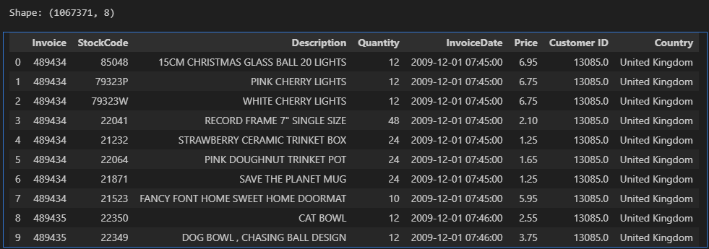
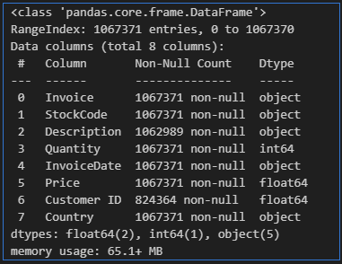
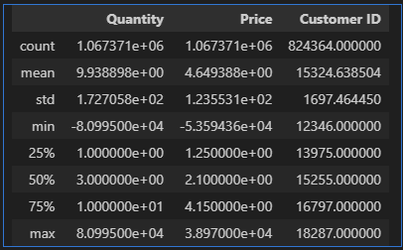
Dataset Composition:
The dataset is huge in size, containing 1,067,371 individual transaction records

Slide 7
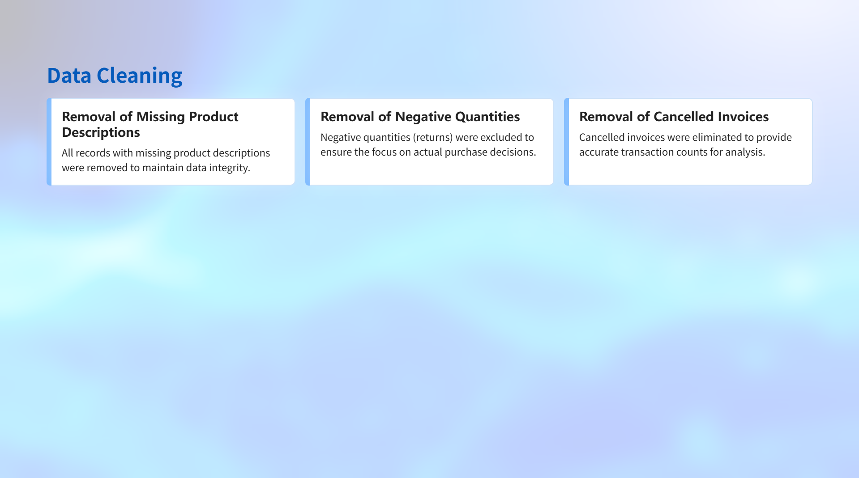
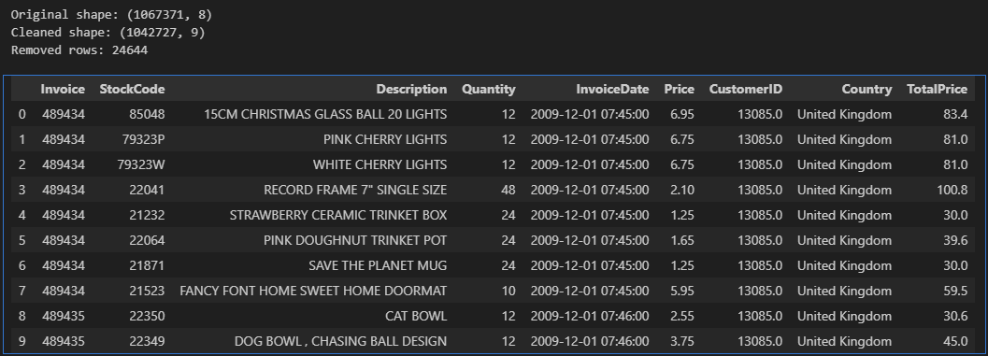

Slide 8
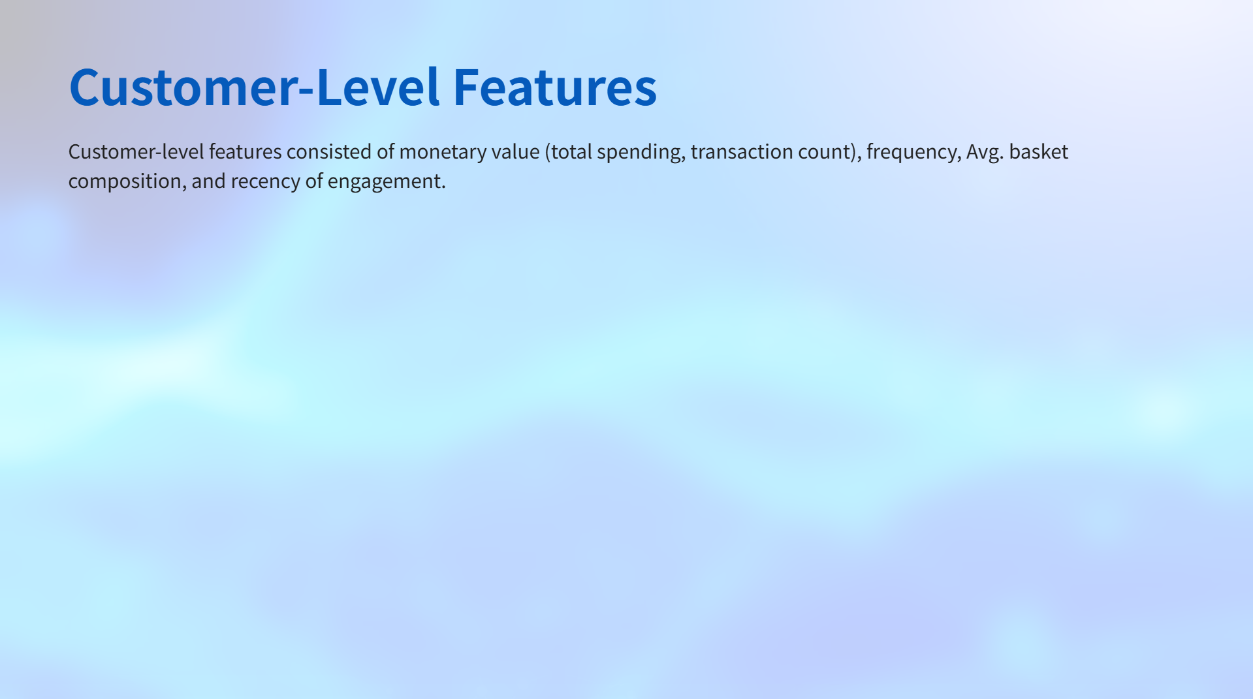
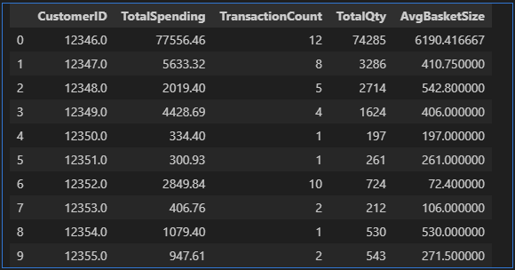
Grouped the data by CustomerID & then calculated aggregates:
Computed Total Spending, Transaction Count, Total Qty and Avg. Basket Size per customer.
Compute Average basket size
= (total items / number of invoices)
Customers aggregated: 5,881

Slide 9
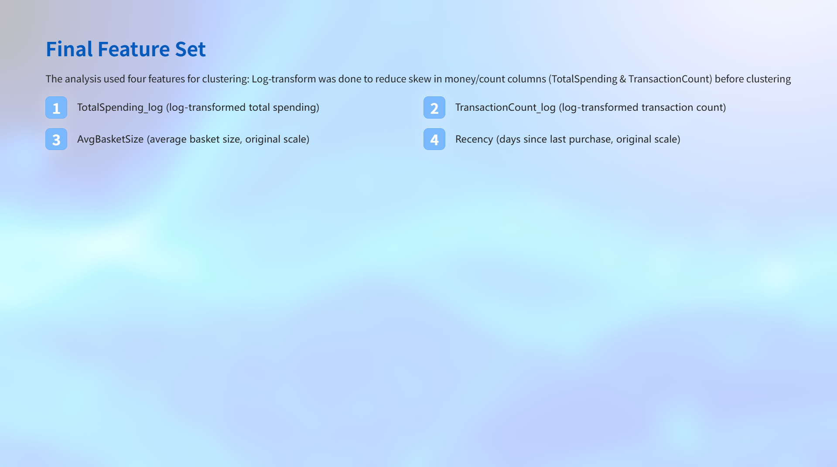
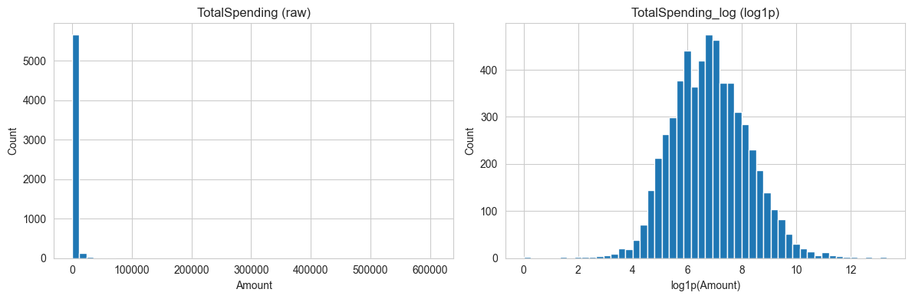

Slide 10
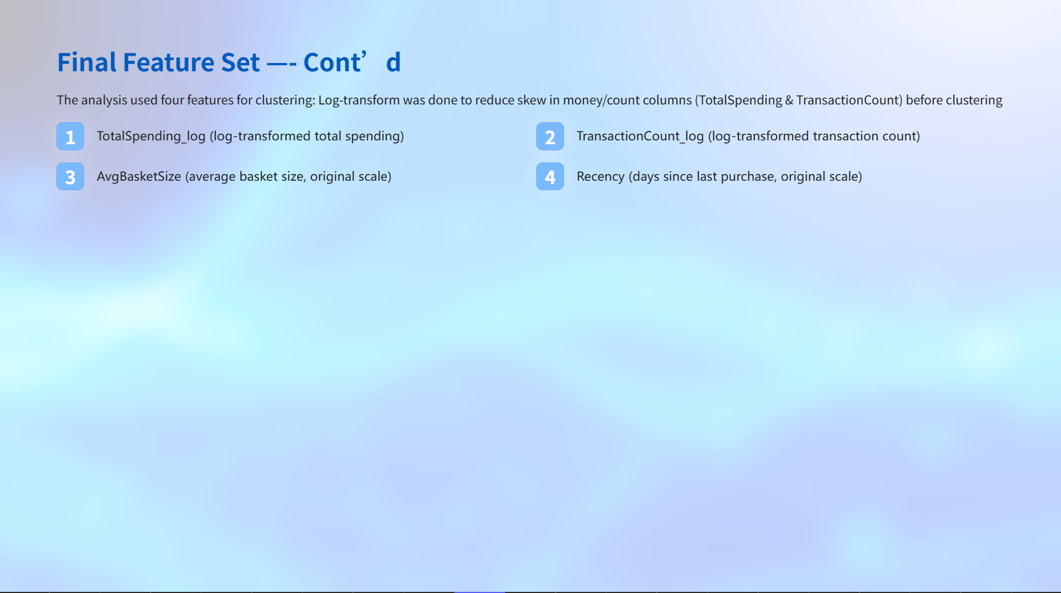
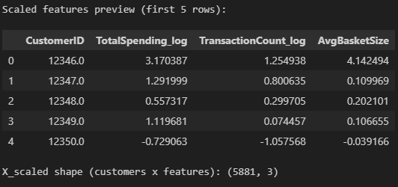
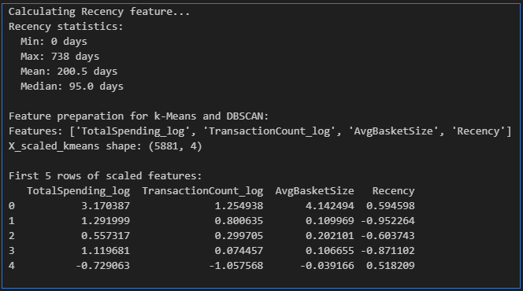

Slide 11
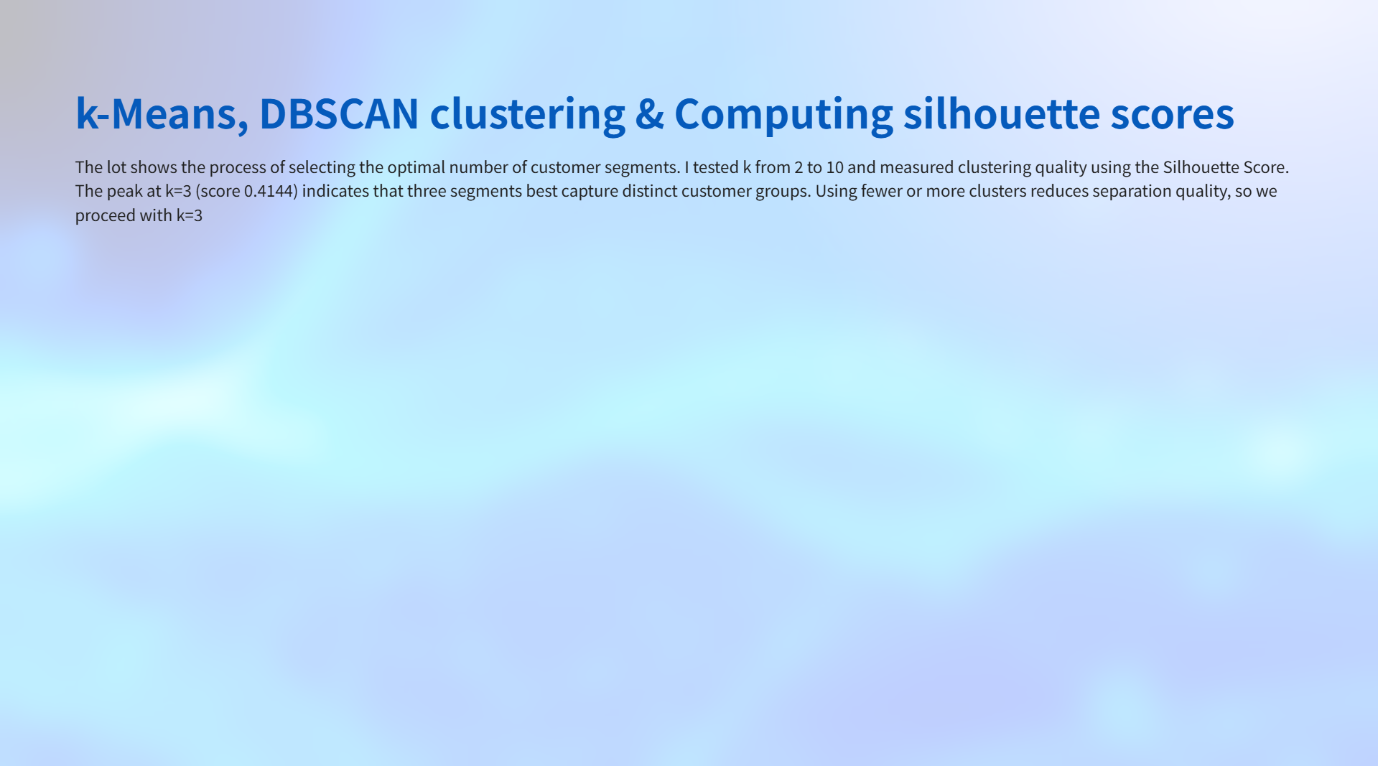
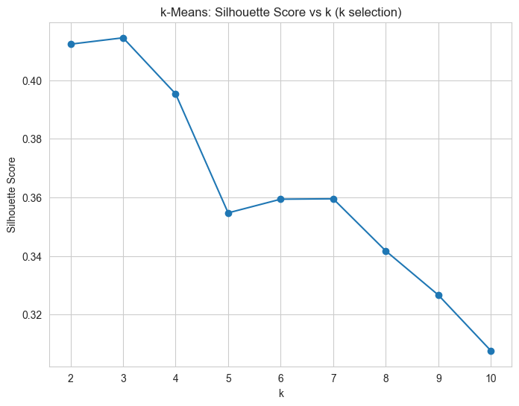
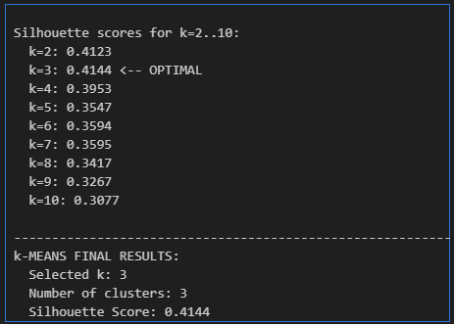
k-MEANS CLUSTERING - Parameter Tuning
Findings
k=3 provides the best separation for this dataset
The score of 0.4144 indicates reasonable clustering quality.
This suggests 3 distinct customer segments

Slide 12
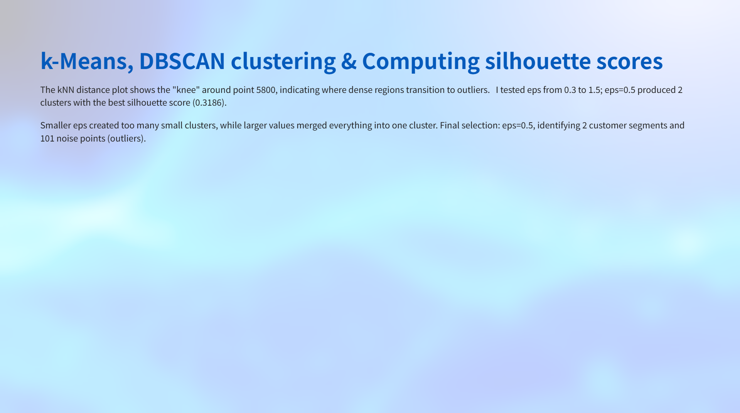
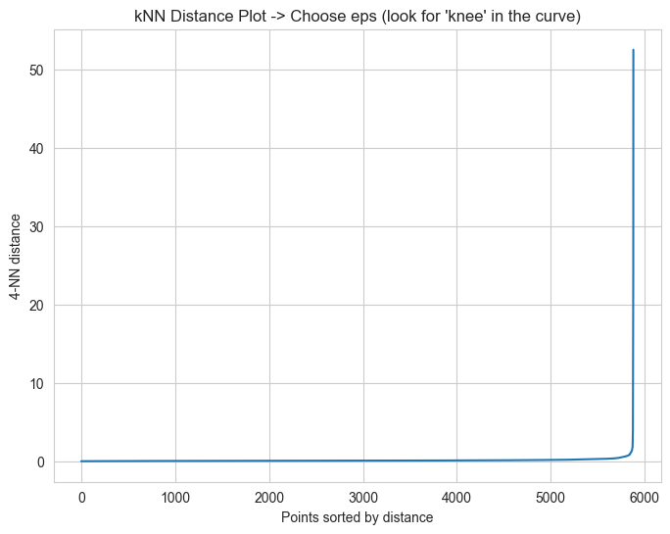
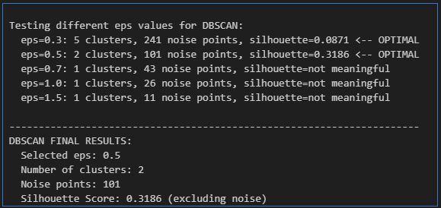
DBSCAN CLUSTERING - Parameter Tuning
Unlike k-Means, DBSCAN automatically flags outliers that don't fit the main segments.

Slide 13
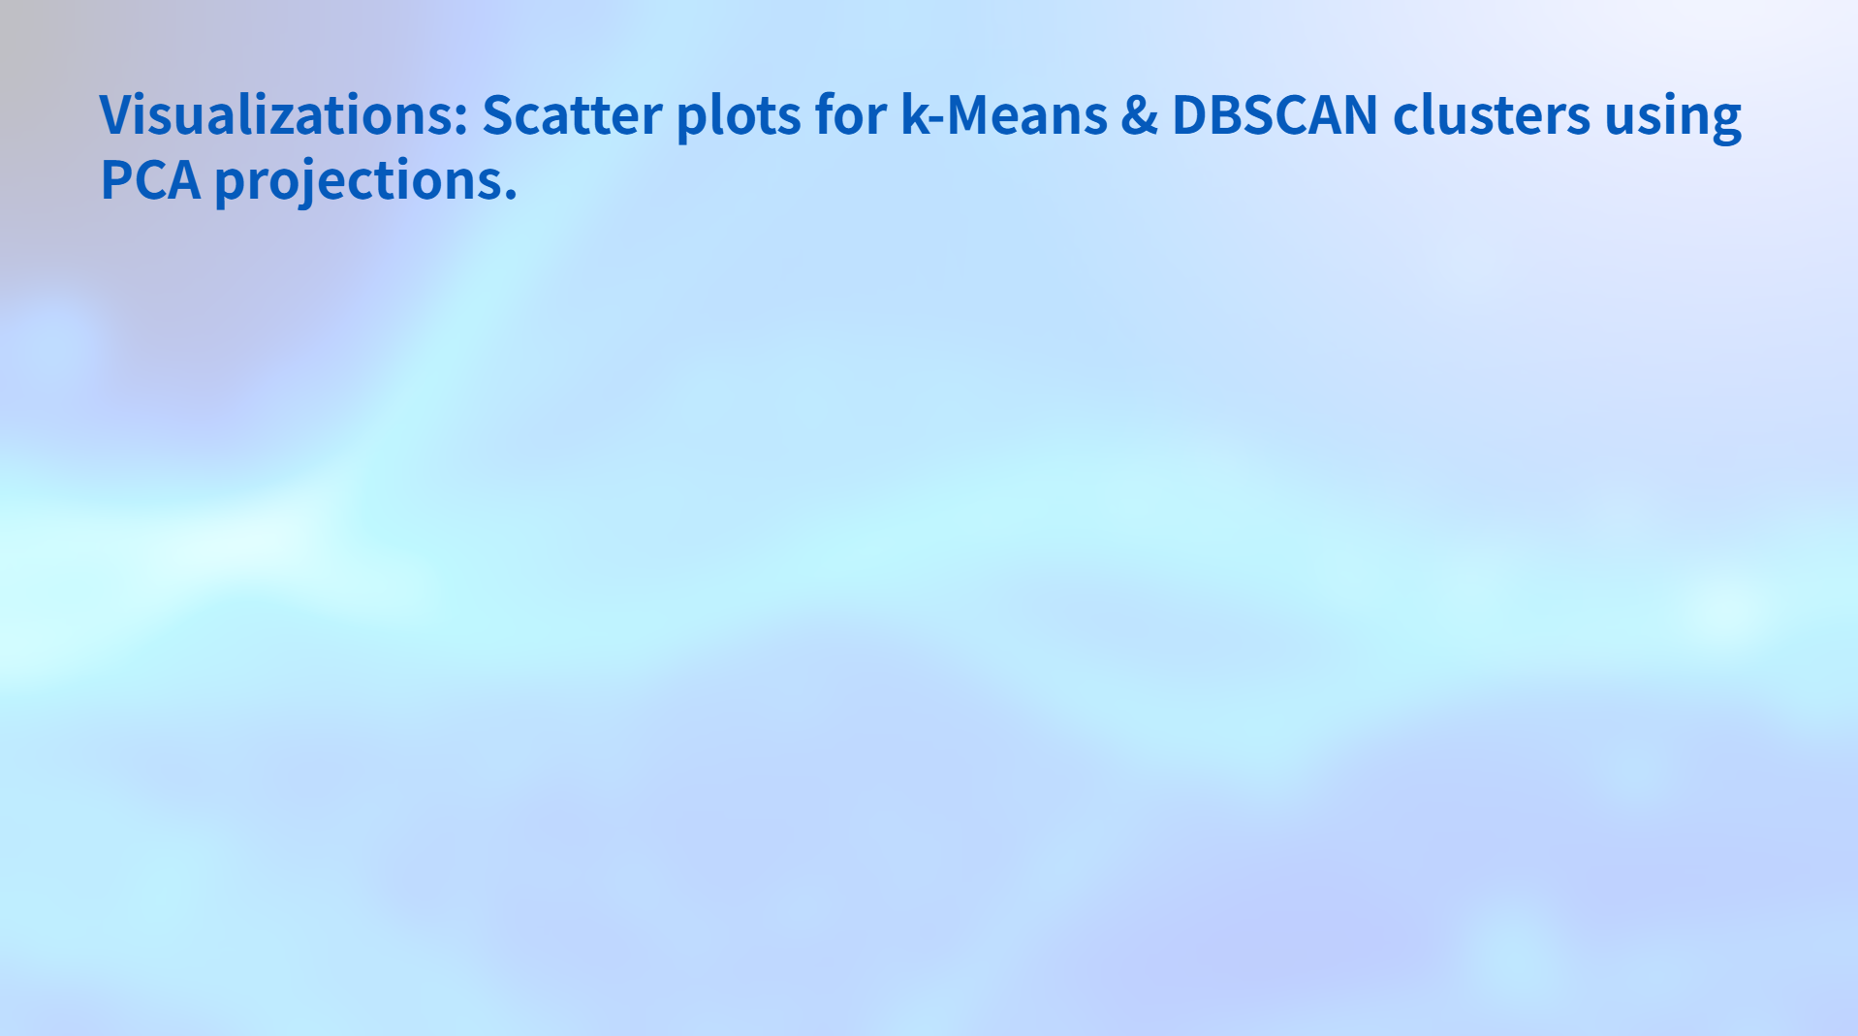
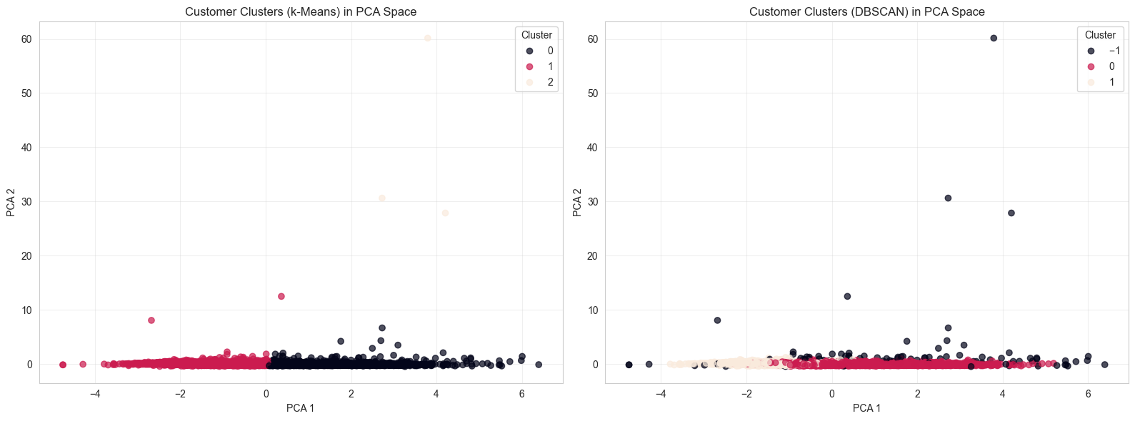

Slide 14
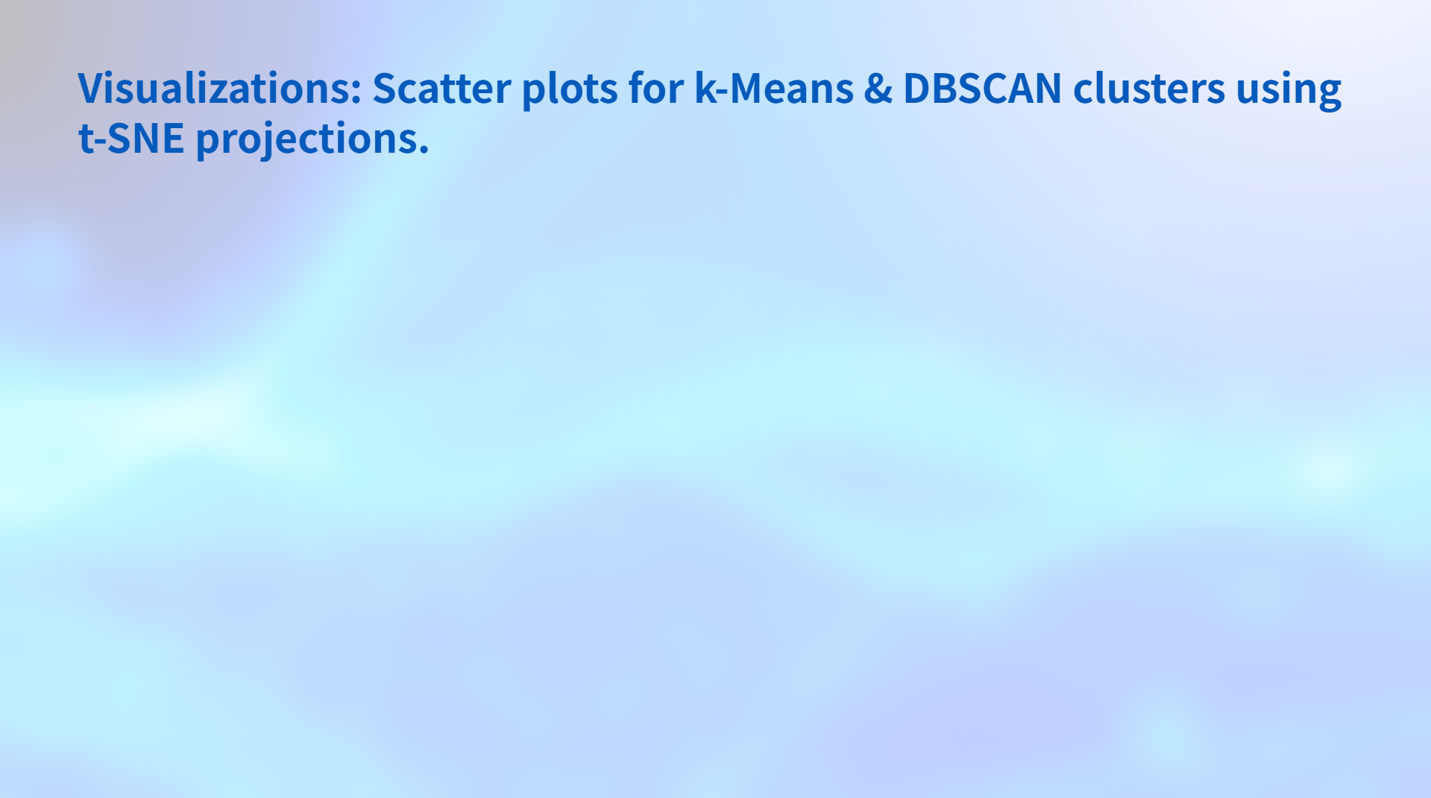
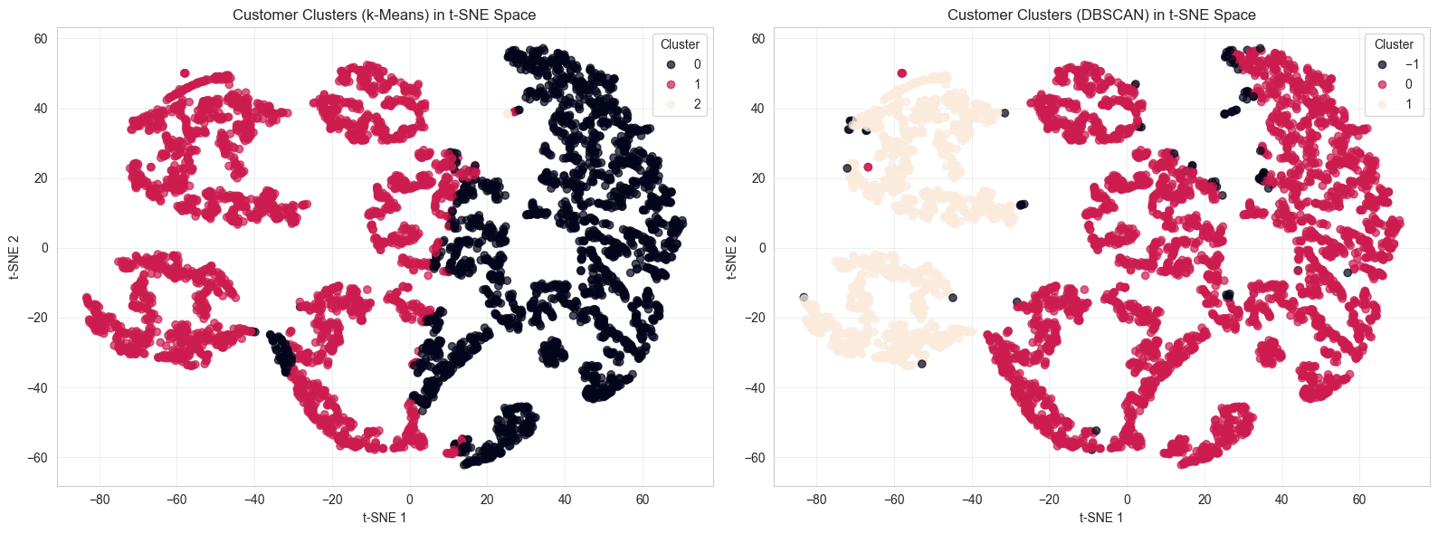
t-SNE is computationally expensive: it scales quadratically with the number of samples (O(n²)).
Used Sub sample of 5000 to keep t-SNE fast on large datasets

Slide 15
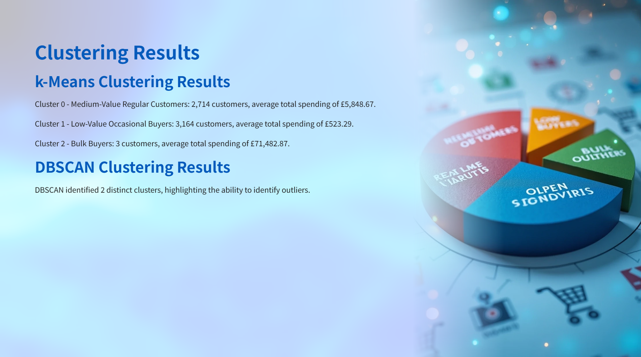
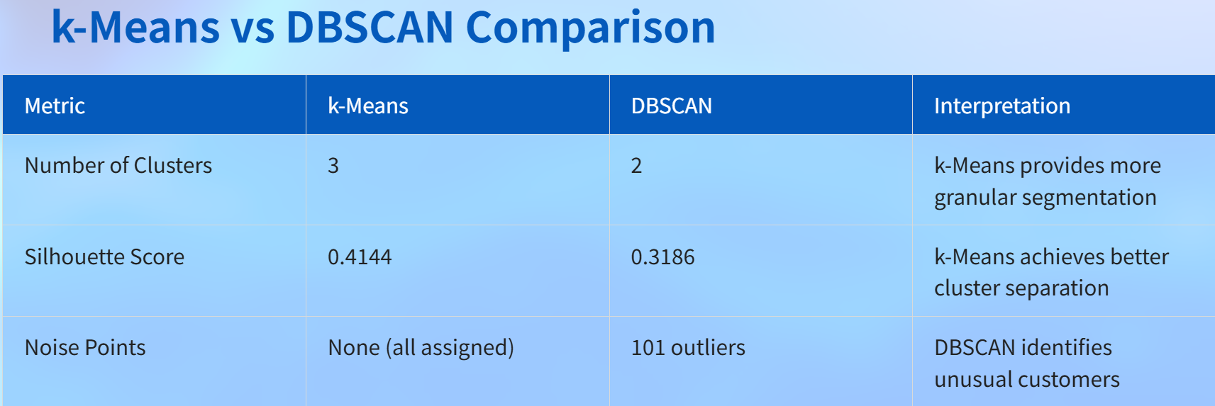

Slide 16
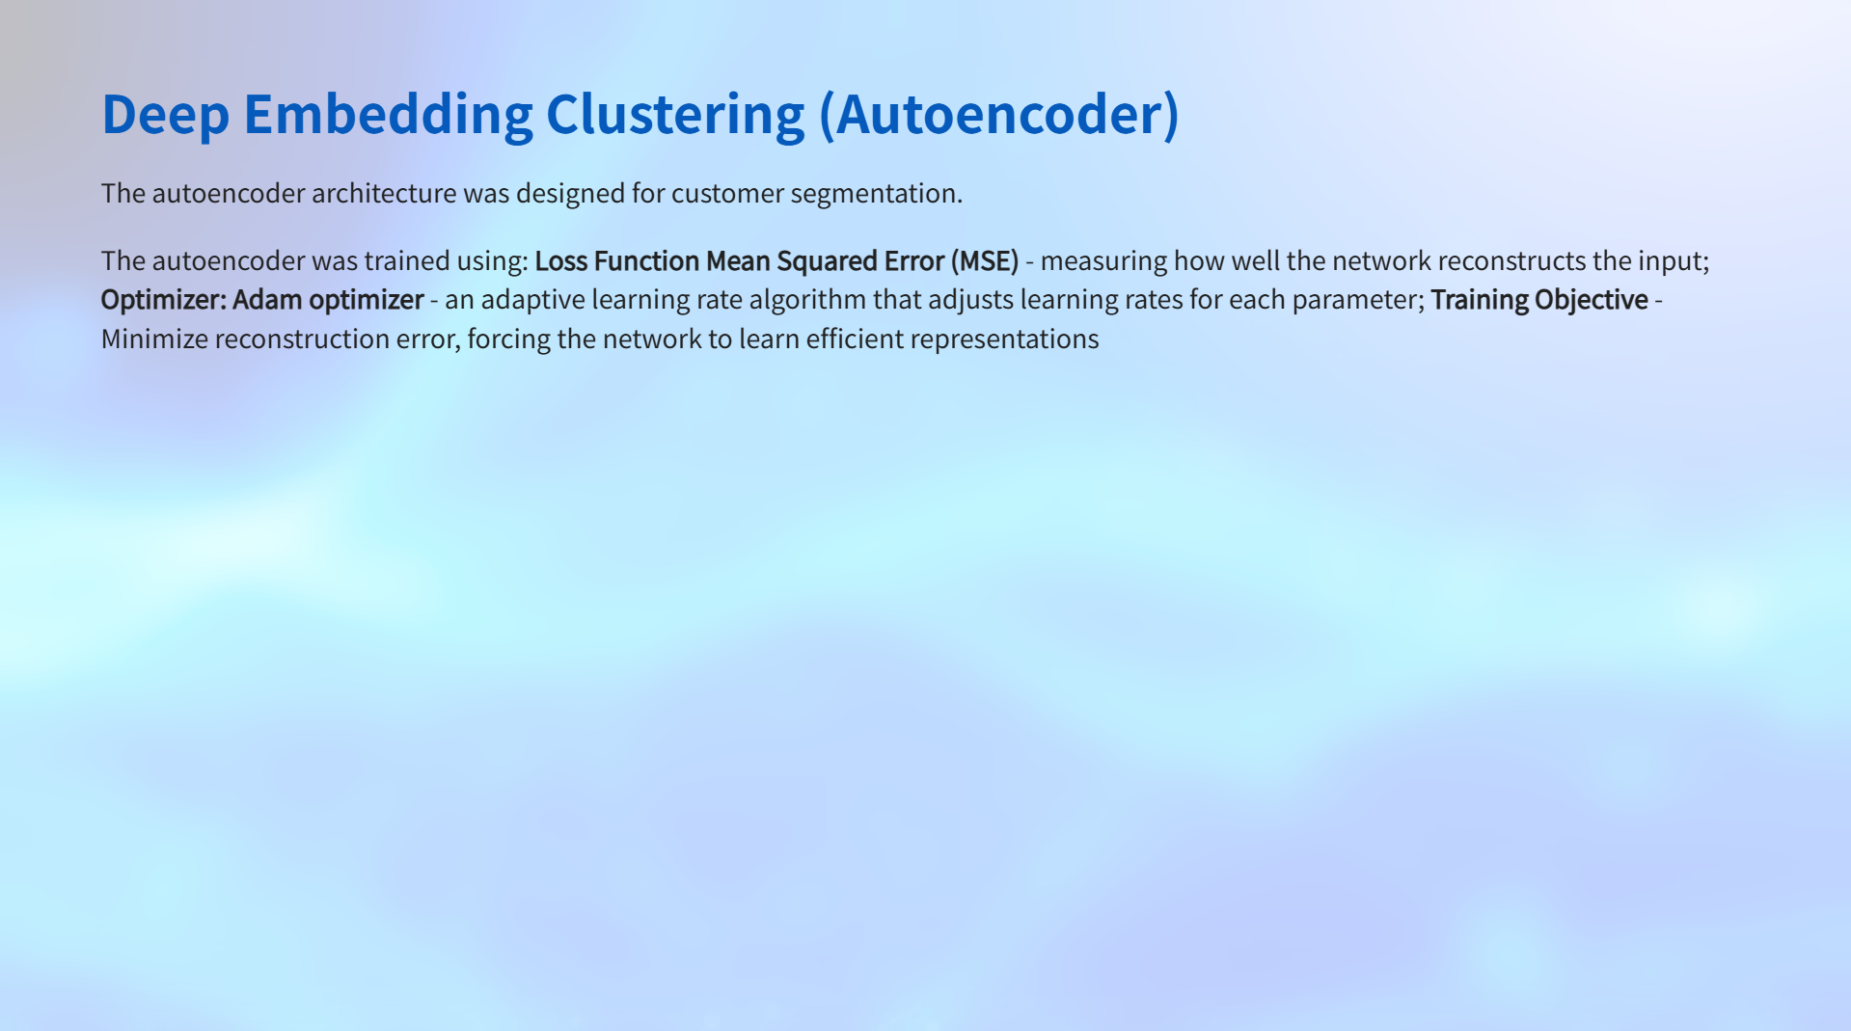
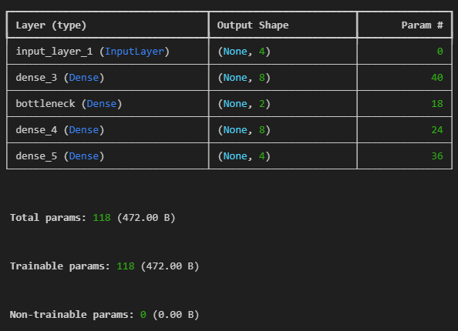
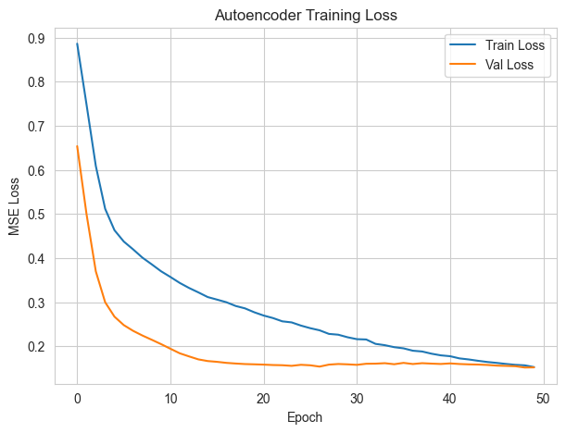

Slide 17
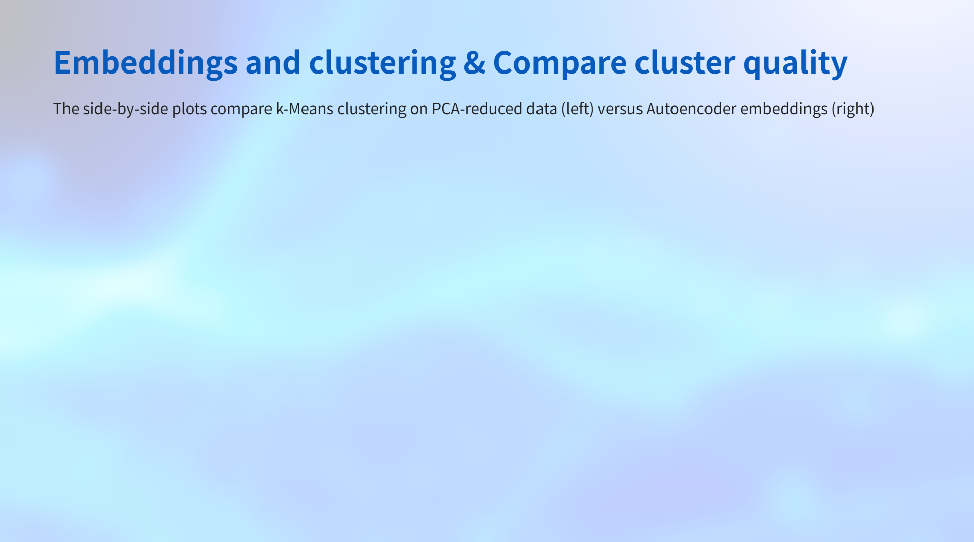
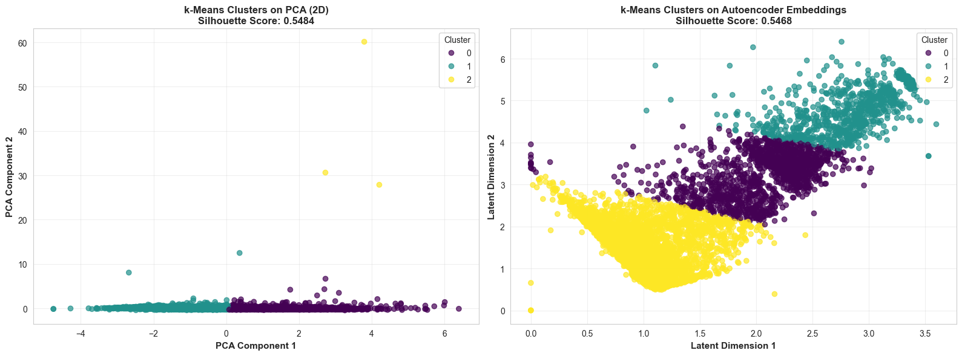
Despite similar silhouette scores, the Autoencoder embeddings show clearer separation. PCA’s score is boosted by the well-separated outliers, while the main clusters overlap.
The Autoencoder learned a latent space that better separates the customer segments, making the clusters more interpretable and actionable for business use.

Slide 18
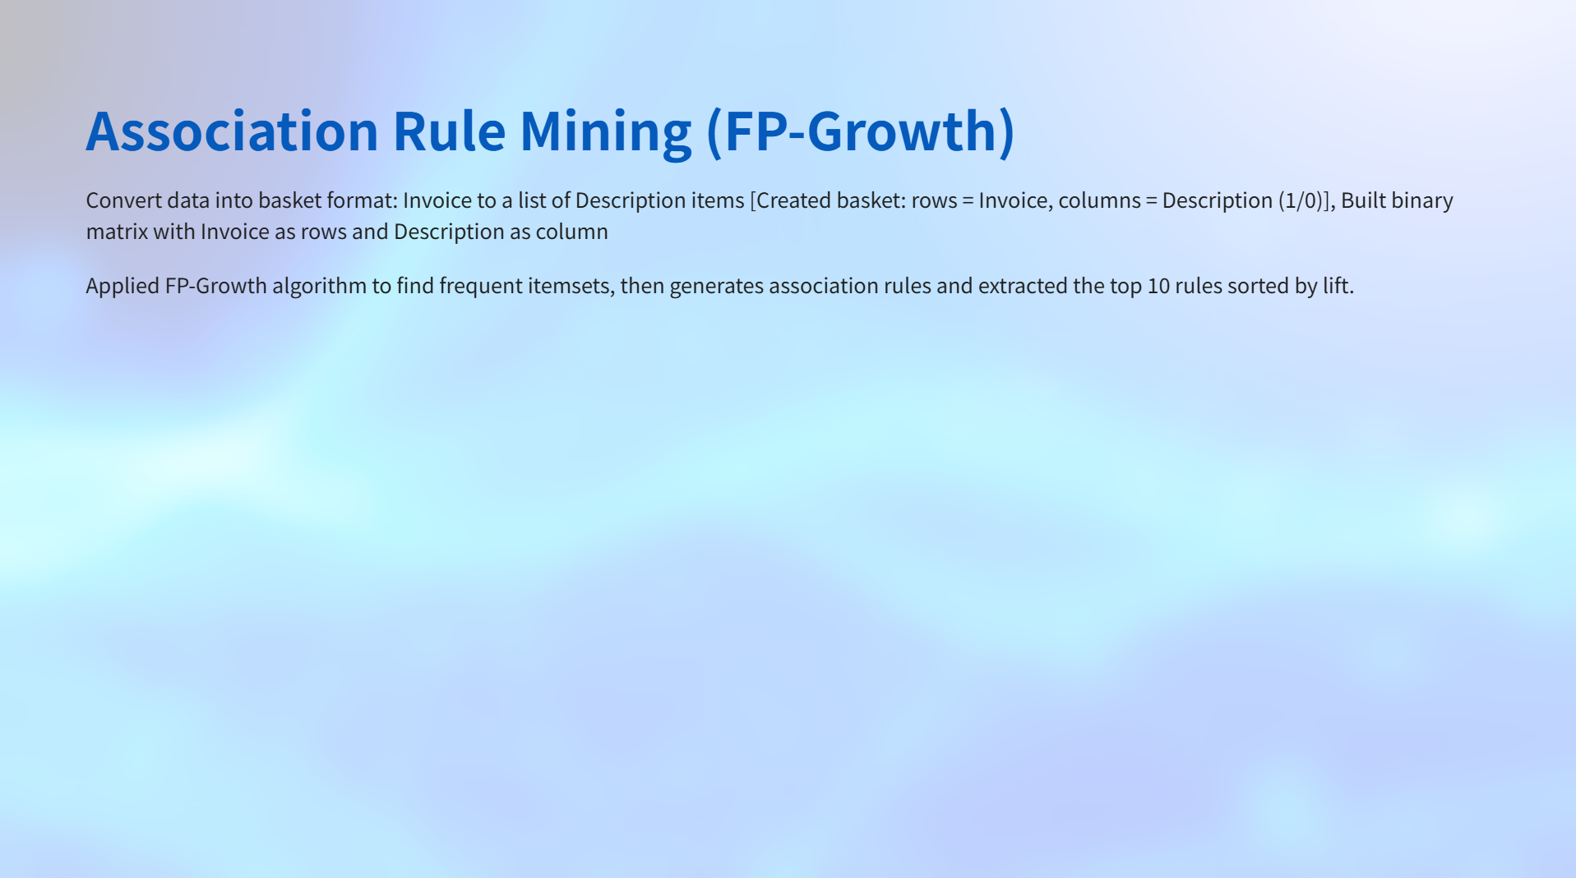
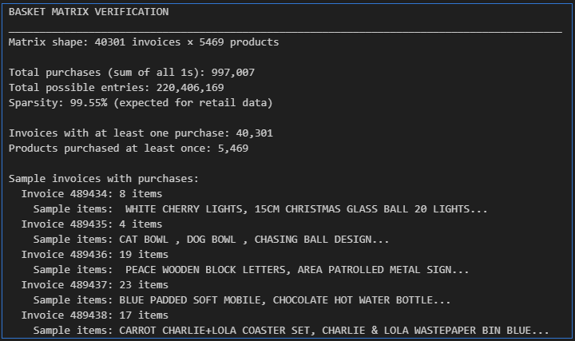
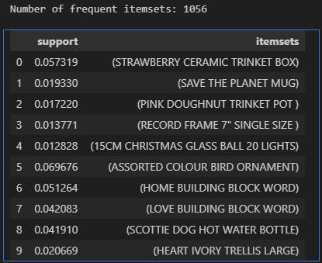

Slide 19
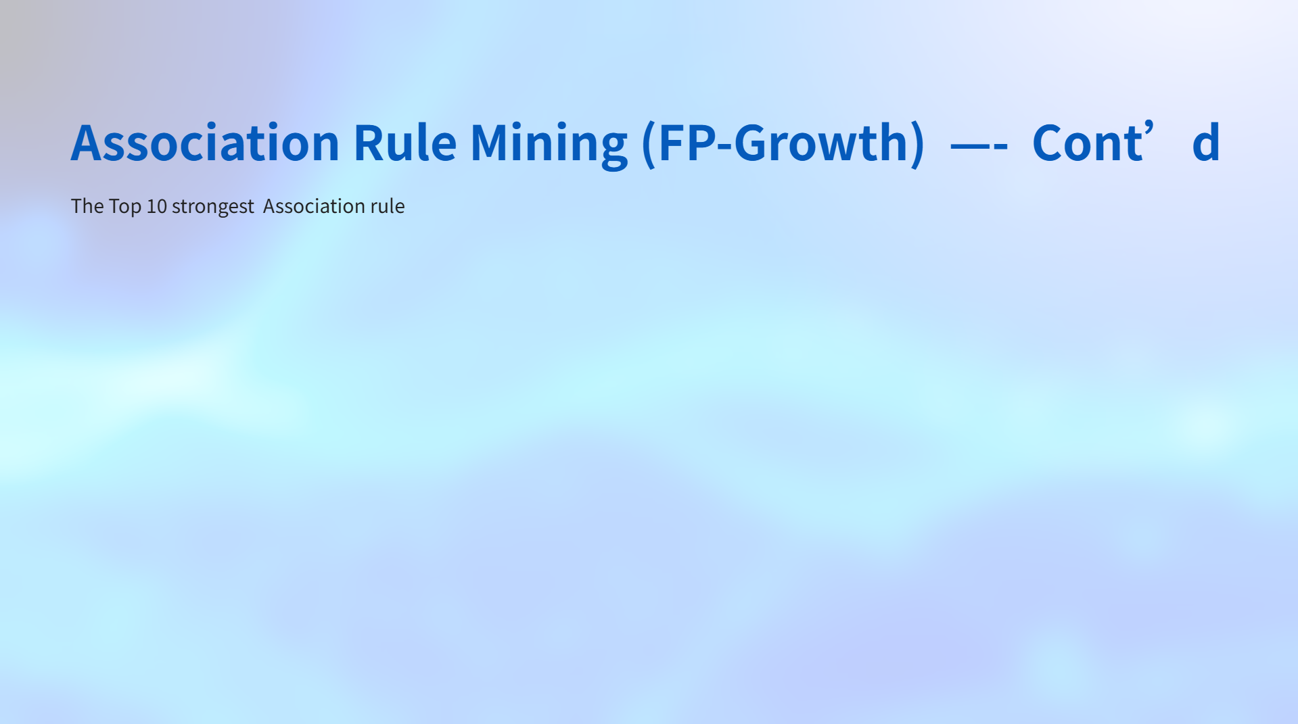
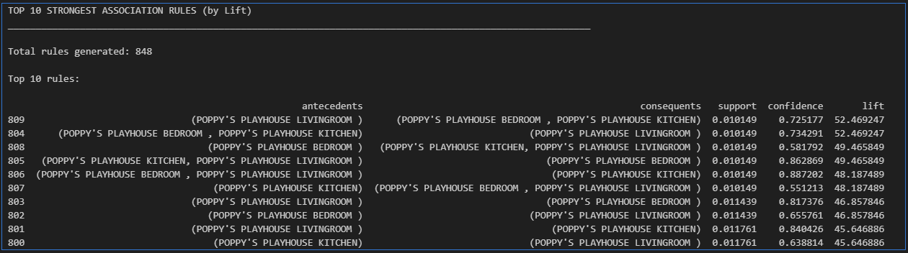
FP-Growth identified 1,056 frequent itemsets and generated 848 association rules, leveraging the insights to inform cross-selling and bundling strategies.

Slide 20
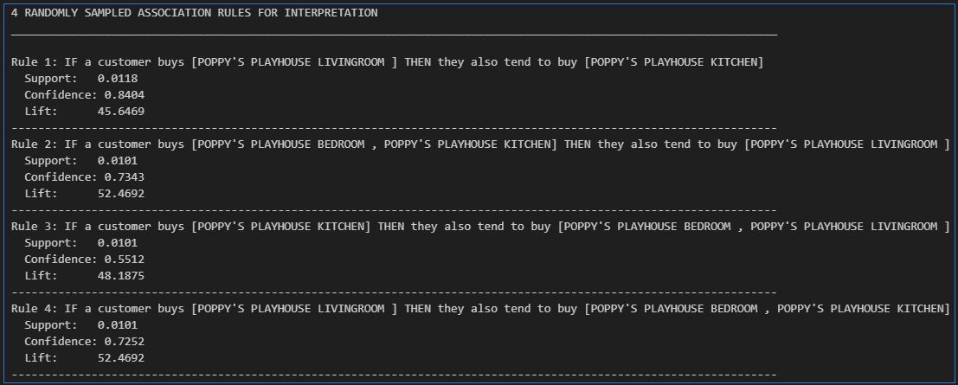

Slide 21

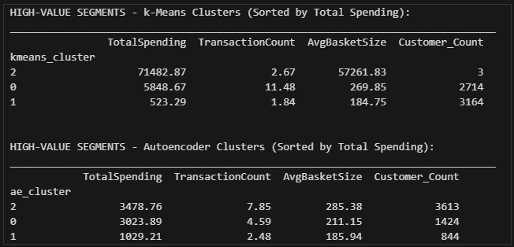
k-Means: Cluster 0=Low-value (62.5%), Cluster 1=Bulk buyers (0.05%), Cluster 2=Medium-value regular (37.5%)
Autoencoder: Cluster 0=Low-value (56.9%), Cluster 1=High-value frequent (12.0%), Cluster 2=Medium-value occasional (31.1%)

Slide 22
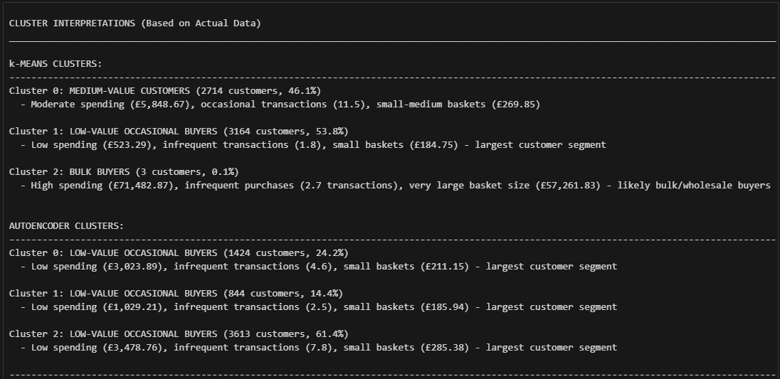

Slide 23
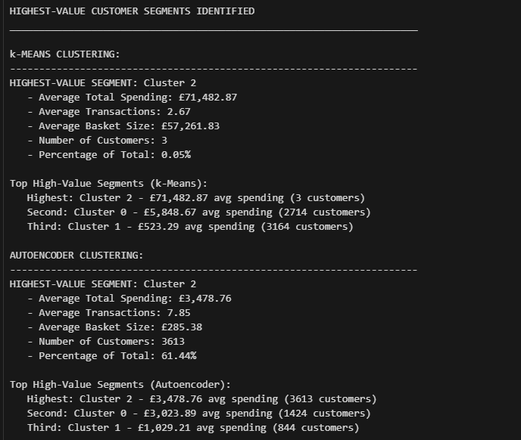
COMPARISON: PCA vs Deep Embedding Clusters
CLUSTERING QUALITY:
k-Means on PCA (2D): 0.5484
k-Means on Autoencoder embeddings: 0.5468
Difference: 0.0017
PCA performs better by: 0.30%

Slide 24
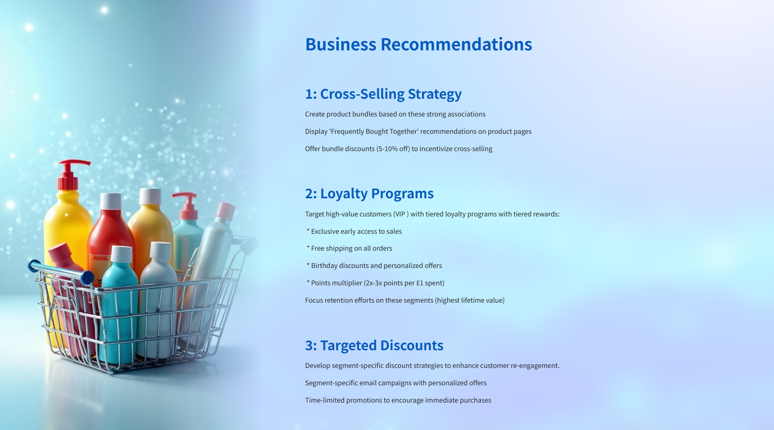

Slide 25


Slide 26

AINEDEMBE DENIS
2024-M132-23999
GitHub Repo:
https://github.com/Ainedembe-Denis/UCI-Online-Retail-II-Customer-Purchasing-Behavior-Analysis

